Slide 1
PRESENTATION
INBOUND TRAVEL INSURANCE
Customer first - Integrity - Innovation - Team work

Slide 2



What is Inbound Travel Insurance?
Inbound Travel Insurance
Insurance for foreign travelers entering Tanzania Mainland.
Cover emergencies for medical expenses, loss of luggage, repatriation and evacuation.
The cover is valid for maximum of 92 days multiple entry.
It was introduced in accordance with amendments of Insurance Act CAP No. 394 , June 2025.

Slide 3
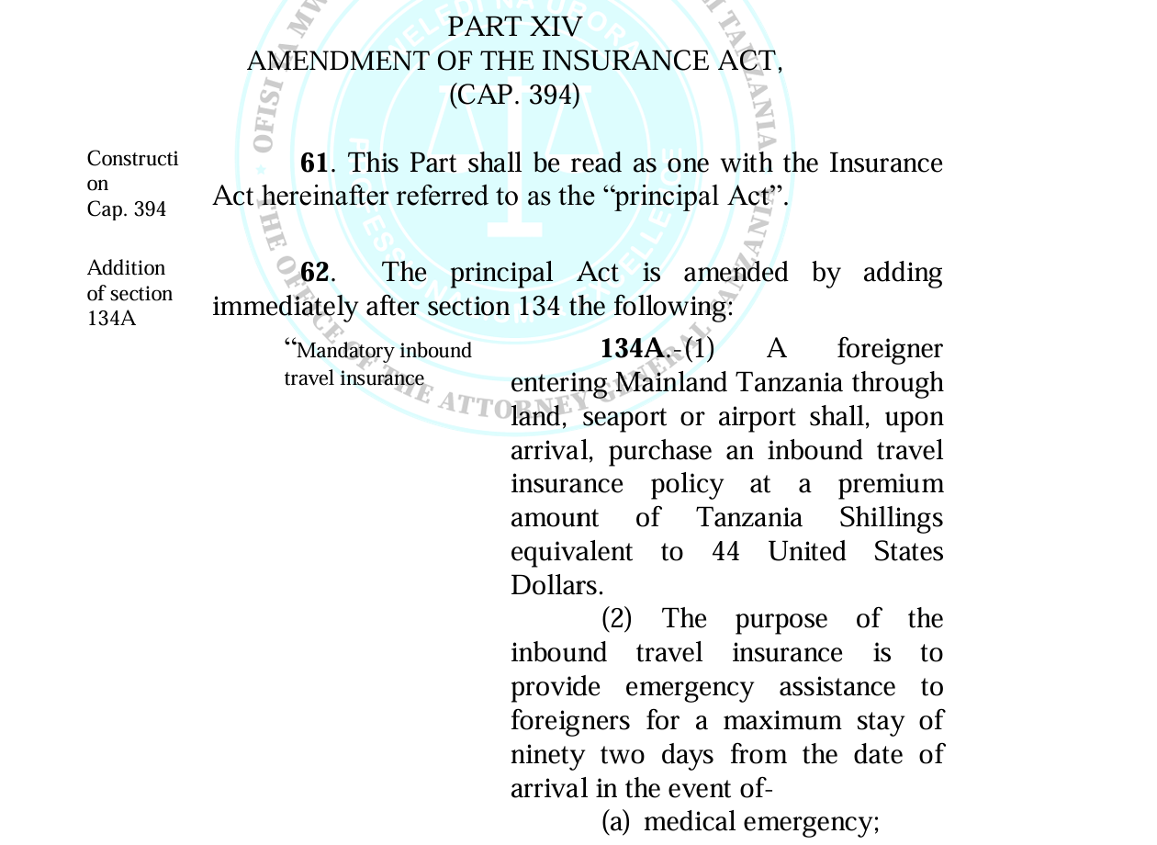
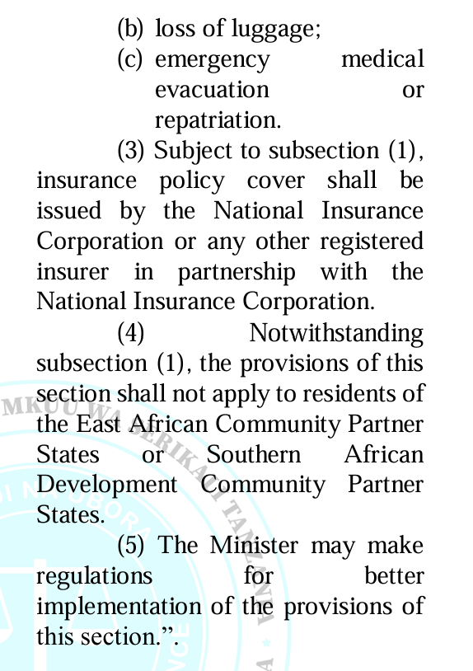
Amendments of Insurance Act CAP 394

Slide 4

Purpose of Inbound Travel Insurance In Tanzania
To Protects travelers coming to Tanzania.
To Provides medical assistance and emergency support on repatriation and evacuation.
Reduce financial risk to the government.
To promote responsible and sustainable tourism.
To provide covers on unexpected events during the trip.

Slide 5
Benefits of Inbound Travel Insurance to NIC
Generates significant premium income and contributes directly to NIC’s overall revenue growth.
Enables NIC to access the international visitor market and expand its customer base.
Strengthens NIC’s position in the general insurance market and increase in customer base.
Enhances NIC’s digital insurance capabilities through online underwriting, payment, verification and policy issuance.
Increases NIC’s visibility among international travelers, tour operators, travel agents and other stakeholders.

Slide 6
Key Activities Undertaken By NIC Towards Implementation Of Inbound Travel Insurance
Activity | Description
1 | Consolidation of stakeholder feedback and alignment of regulatory content.
2 | Development of draft regulations in collaboration with the Ministry of Finance, TIRA and key stakeholders.
3 | Product development and reinsurance arrangements.
4 | System development and integration with key stakeholders – Immigration, Bank, and ZIC.
5 | Human resource analysis.
6 | Identification of key entry points.
7 | Extension of call center services for inbound travel insurance.
8 | Analysis of procured items like ICT equipment and promotional materials.
9 | Public education and Advertisement .

Slide 7
Key Partners and Service Providers
NMB BANK | IMMIGRATION DEPARTMENT
Support in premium collection. | Support policy verification.
Underwriting support. | Policy activation.
Policy verification. | Deny entry to a foreigner entering Mainland Tanzania without a valid inbound travel insurance policy.
Policy activation. | Facilitate integration between the immigration information system and inbound travel insurance system.
Receive notifications of claims from policyholder and communicate to insurer. | Provide data and information required for implementation of inbound travel insurance.
Provide the insurer with timely and accurate reports on daily basis. | Designate a focal person to coordinate the implementation of the integrated system.

Slide 8
Key Partners and Service Providers
ZANZIBAR INSURANCE CORPORATION (ZIC) | MAPFRE
Develop, operate and maintain the inbound Travel Insurance information Management system. | Acts as the reinsurer.
Provide NIC with secure access for verification of inbound travel insurance policy issued by ZIC through system integration. | Claims service provider and call center.
Establish a joint website to facilitate purchase of inbound travel insurance for foreigners entering United Republic of Tanzania.

Slide 9
List of entry points in Mainland Tanzania-AIRPORTS
SN | AIRPORT NAME | NUMBER OF ASSISTANT CORDINATORS (STAFF FROM NIC) | NUMBER OF NMB STAFF
1 | Julius Nyerere International Airport (JNIA),Terminal 1,2,3 | Justine Bandoma Anthonia Mmbando Leah Kiteshuo Herman Mushi Elizabeth Matondo Zuhura Bashiri | 24
2 | Kilimanjaro International Airport (KIA). | Henry Mwankenja Florance Moshi | 14
3 | Songwe Airport | Catherine Ngamila | 2
4 | Mwanza Airport | Hakeem Mwaruka Rafat Hussein | 2
5 | Arusha Airport | Ezekia Nkoko Zuhura Mussa | 6

Slide 10
List of entry points in Mainland Tanzania- LAND BOARDERS
SN | ENTRY POINT NAME | NUMBER OF ASSISTANT CORDINATOR(STAFF FROM NIC) | NUMBER OF NMB STAFF
1 | Sirari Boarder | Pili Salum and Honest Valence | 12
2 | Tarakea Boarder | Martin Mfinanga | 2
3 | Horohoro Boarder | Nicodemus Dionise | 2
4 | Tunduma Boarder | Michael Msati | 4
5 | Rusumo Boarder | Pendo Lumwe | 2
6 | Namanga Boarder | Benjamin Mahumbali Boniface Meela | 12
7 | Holili Boarder | Kiriwe Mohamed | 4
8 | Mtukula Boarder | Alfred Bwojo | 2

Slide 11

Features for Inbound Travel Insurance
The cover is mandatory to all foreigners traveling to Tanzania.
Is intended for foreigners entering through land boarders, seaports and airports.
Coverage effective upon arrival.
The cover is valid for 92 days.

Slide 12
Features for Inbound Travel Insurance
Financial protection in case of emergency medical expenses, loss of baggage, repatriation and Evacuation.
The cover excludes all foreigners who are residents of the East African Community (EAC) Partner States or Southern African Development Community (SADC) Partner States.
The premium for the cover is USD 44 subject to eligible discounts.
The cover is eligible for multiple entry.

Slide 13

Who is not covered ?
Residents of Tanzania.
Foreigner with working permit/residential permit.
Diaspora.
Diplomats.
Transit Passengers.
All foreigners who are residents of the EAC Partner States or (SADC) Partner States.

Slide 14

Package of Inbound Travel Insurance
There are three package.
Individual Package
Family Package
Group Package

Slide 15

Package of Inbound Travel Insurance
Individual Package
Consist of 1 -2 people
Pricing is as follows:
Infants (Aged 0-2): Free of charge.
Children (Aged 3-17):50% discount on the standard price.
Adults (Aged 18 and above): Pay the full price

Slide 16

Package of Inbound Travel Insurance
Family Package
Consist of 3-9 people
Pricing is as follows
Infants (Aged 0-2): Free of charge.
Children (Aged 3-17): 50% discount on the standard price.
Adults (Aged 18 and above): Pay the full price.

Slide 17

Package of Inbound Travel Insurance
Group Package
Consist of 10 or more people
Pricing is as follows;
Infants (Aged 0-2): Free of charge.
Children (Aged 3-17): 50% discount on the standard price.
Adults (Aged 18 and above): 10% discount on the standard price.

Slide 18
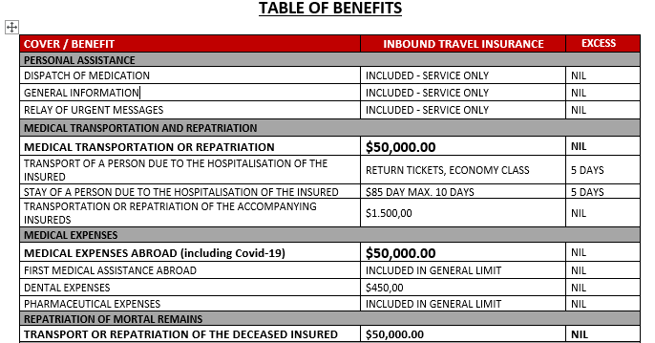
Benefits of Inbound Travel Insurance

Slide 19
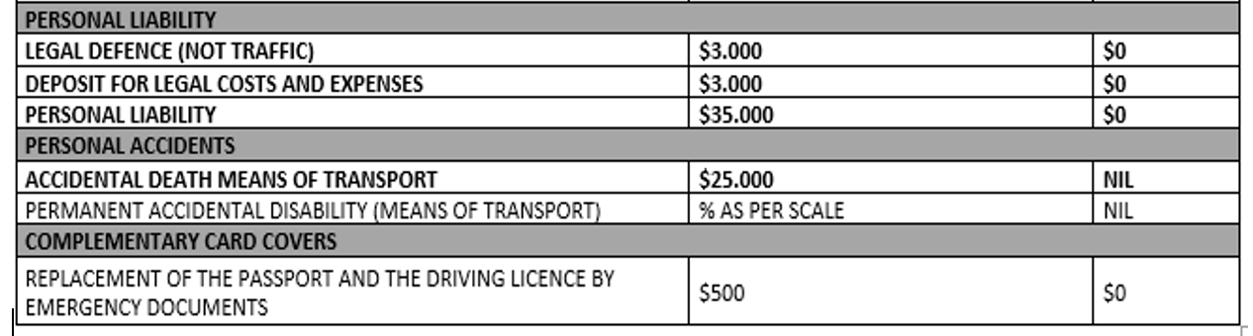
Benefits of Inbound Travel Insurance

Slide 20
What is not covered/ exclusions
Losses arising from criminal acts, fraud, gross negligence, or reckless conduct.
Extraordinary natural phenomena such as tsunamis, earthquakes, landslides, volcanic eruptions, floods atypical cyclonic storms.
Events arising from terrorism, mutiny or crowd disturbances.
Claims arising from natural catastrophes, epidemics, or pandemics are excluded unless specifically covered under the policy.

Slide 21
What is not covered/exclusions
Losses arising from war, whether declared or undeclared, and from armed conflicts or international interventions.
Work-related or manual labour accidents arising from hazardous or high risk occupational activities.
Treatment of pre-existing medical conditions.
use of alcohol, drugs, toxic substances, narcotics, or non-prescribed medication.

Slide 22
Underwriting details required –Inbound Travel Insurance
Underwriting can be done through online though link https://inbound.nicinsurance.co.tz and upon arrival at NIC and NMB counter.
Required Details are;
Passport Number .
Travelers full names and birth date.
Nationality and country of residence.
Arrival date and departure date.
Purpose of travel.
Insured contract details and emergence contracts(phone and email address).
First entry point into Tanzania.
Premium payment confirmation.

Slide 23
Payment Methods
After completion of underwriting process and confirmation of premium summary, the customer will have two payment options;
Online payment-payment can be made online using visa or master card.
Payment upon arrival- the customer may pay upon arrival at designated NIC and NMB counter at entry points.

Slide 24
How should the insured apply for claim assistance?
In the event of a claim the policyholder or any person acting in his place shall communicate with insurer though;
Emergency Telephone number International: +255 0736100800
Emergency Telephone number Local:+255 0800110041
Email address: wecare.inbound@nicinsurance.co.tz
He/she will be prompted to provide: Passport or Identity card number or Policy number, full name of the injured and the principal insured, and the cause of the call and the place he/she is located (Hotel/City/Address/Phone number).

Slide 25
Reference documents for Inbound Travel Insurance
Insurance Act CAP 394,Amendments of June 2025.
The Insurance(Inbound Travel Insurance)Regulations,2026.
Inbound Travel Insurance Policy wordings .
Inbound Travel Insurance Certificate.
FAQ,s, MOU’s.
Marketing Materials.

Slide 26
Questions and Answers
Discussion.
Question and Answers.

Slide 27
ASANTE

